Slide 1

DS Casino and Sportsbook
An Overview of Data Science Terms and Techniques and Their Applications in the Casino and Sportsbook Industries

Slide 2

What is Data Science?
Data Science involves the principles, processes, and techniques for understanding phenomena via the automated analysis of data.
The ultimate goal of data science is to improve decision making.
Data, and the capability to extract useful knowledge from data, should be regarded as a key strategic asset in business.
Your data and its procurement should be considered a business investment.

Slide 3
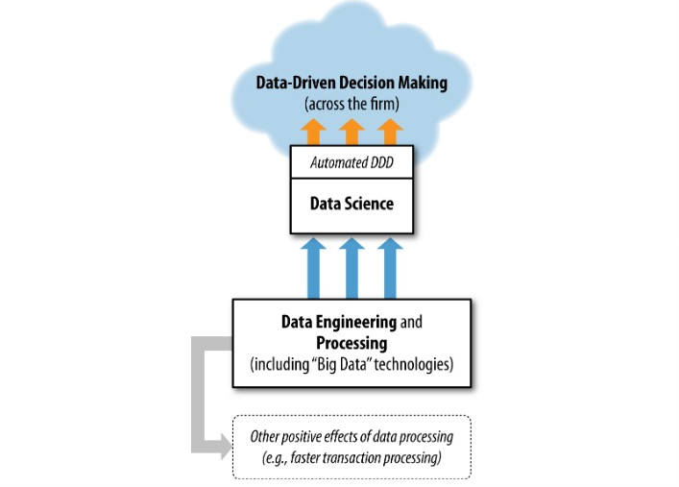
Data-Driven Decision-making (DDD)
Refers to the practice of basing decisions on the analysis of data, rather than purely on intuition.
Not an all-or-nothing practice.
Can be engaged in greater or lesser degrees based on the needs of the business/decision to be made.
Two types of decisions for which DDD will be useful:
1.) Decisions for which “discoveries” need to be made within the data.
2.) Decisions that repeat, especially at massive scale, and so decision-making can benefit from even small increases in decision-making accuracy based on data analysis.

Slide 4

Big Data technologies
“Big data” technologies (such as Hadoop, HBase, and MongoDB) are essentially datasets that are too large for traditional data processing systems and require new processing technologies.
Used for many tasks, including data engineering and data processing.
Can help many data-oriented business tasks that do no involve extracting knowledge or DDD, such as efficient transaction processing, modern web system processing, and online advertising campaign management.
Occasionally used for implementing data mining techniques.
Data science needs access to data and it often benefits from sophisticated data engineering that data processing technologies may facilitate.
These technologies are not data science technologies but help support data science in general.

Slide 5
Potential benefits of DDD and Big Data Tech
Economist Erik Brynjolfsson and his colleagues from MIT and Penn’s Wharton School conducted a study of how DDD affects firm performance (Brynjolfsson, Hitt, & Kim, 2011).
They developed a measure of DDD that rates firms as to how strongly they use data to make decisions across the company.
Study showed, statistically, the more data-driven a firm is, the more productive it is.
One standard higher deviation on the DDD scale is associated with a 4%-6% increase in productivity.
DDD is also correlated with a higher return on assets, return on equity, asset utilization, and market value.
A study conducted by economist Prasanna Tambe of NYU’s Stern School examined the extent to which big data technologies seem to help firms in the field of data science and decision making (Tambe, 2012).
He finds that using big data technologies is associated with significant additional productivity growth.
One standard deviation of higher utilization of big data technologies is associated with a 1%-3% higher productivity than the average business.
This can lead to potentially large productivity differences for business operating at the extremes.

Slide 6
Potential areas to collect data in casinos/Sportsbooks
1.) Player Card Information:
A patron’s ‘player card’ will house a significant amount of data pertaining to the player.
What kind of games they tend to play/for how long they tend to play them.
How often they tend to gamble in a given time frame (day, week, month, year, etc.).
2.) Giveaways:
For every giveaway or promotional event you do, you can collect data on the demographics of players that respond to said giveaways and promotions and how those promotions affected the player’s engagement in the business.

Slide 7
Potential areas to collect data in casinos and Sportsbooks Cont.
3.) Hotel/Restaurant Guests:
Most casinos operate with extra amenities other than gambling. For example, most have a casino and a restaurant that patrons can use. You can collect and analyze data from these individuals to see if these are areas that can improve gambling retention, player satisfaction, etc.
4.) Sportsbook Account Information:
Since most sportsbook are operated through an app where players are forced to create an individual account, you have a direct platform that collects individual player data through said account.
Examples: How often the user plays parlays. How many bets they make per day. Which sports they bet on the most.

Slide 8
Potential use cases for data science in casinos and sportsbooks
1.) Gambling retention:
Use data collected to determine which activities, giveaways, events, or promotions contribute the most to keeping players gambling the longest.
2.) Player Satisfaction:
Use data collected to determine what events contribute the most to player satisfaction (winning, giveaways, socializing, etc.).
3.) Casino profitability:
Use data collected to determine which games contribute the most to profitability while still being a popular game to play for the patrons.

Slide 9
Potential use cases for data science in casinos and sportsbooks Cont.
4.) Sportsbook profitability:
Use data collected from sportsbook app to determine which types of bets are the most profitable (straight, prop, parlays) versus which bets are most popular, and determining how you can correlate the most profitable and the most popular to maximize profit.
5.) Promotional Giveaways:
Use data collected from both the casino and sportsbook to determine which promotional giveaways correlate directly with increased player retention and increased betting. You can also use this data to determine which marketing campaigns will be most effective for gaining new customers, retaining current customers, and increase activity from both in the future.

Slide 10
References
1.) Wheelan, C. (2013). Naked Statistics: Stripping the Dread from the Data. W.W. Norton & Company.
2.) Provost, F., & Fawcett, T. (n.d.). Data Science for Business. Retrieved from https://platform.virdocs.com/read/542691/389/#/4/4.
3.) Brynjolfsson, E., Hitt, L. M., & Kim, H. H. (2011). Strength in numbers: How does data-driven decision making affect firm performance? Tech. rep., available at SSRN: http://ssrn.com/abstract=1819486 or http://dx.doi.org/10.2139/ssrn.1819486.
4.) Tambe, P. (2013). Big Data Investment, Skills, and Firm Value. Working Paper, NYU Stern. Available: http://papers.ssrn.com/sol3/papers.cfm?abstract_id=2294077.

